Slide 1
Athletic Information* Edited to include answers to parent questions

Slide 2
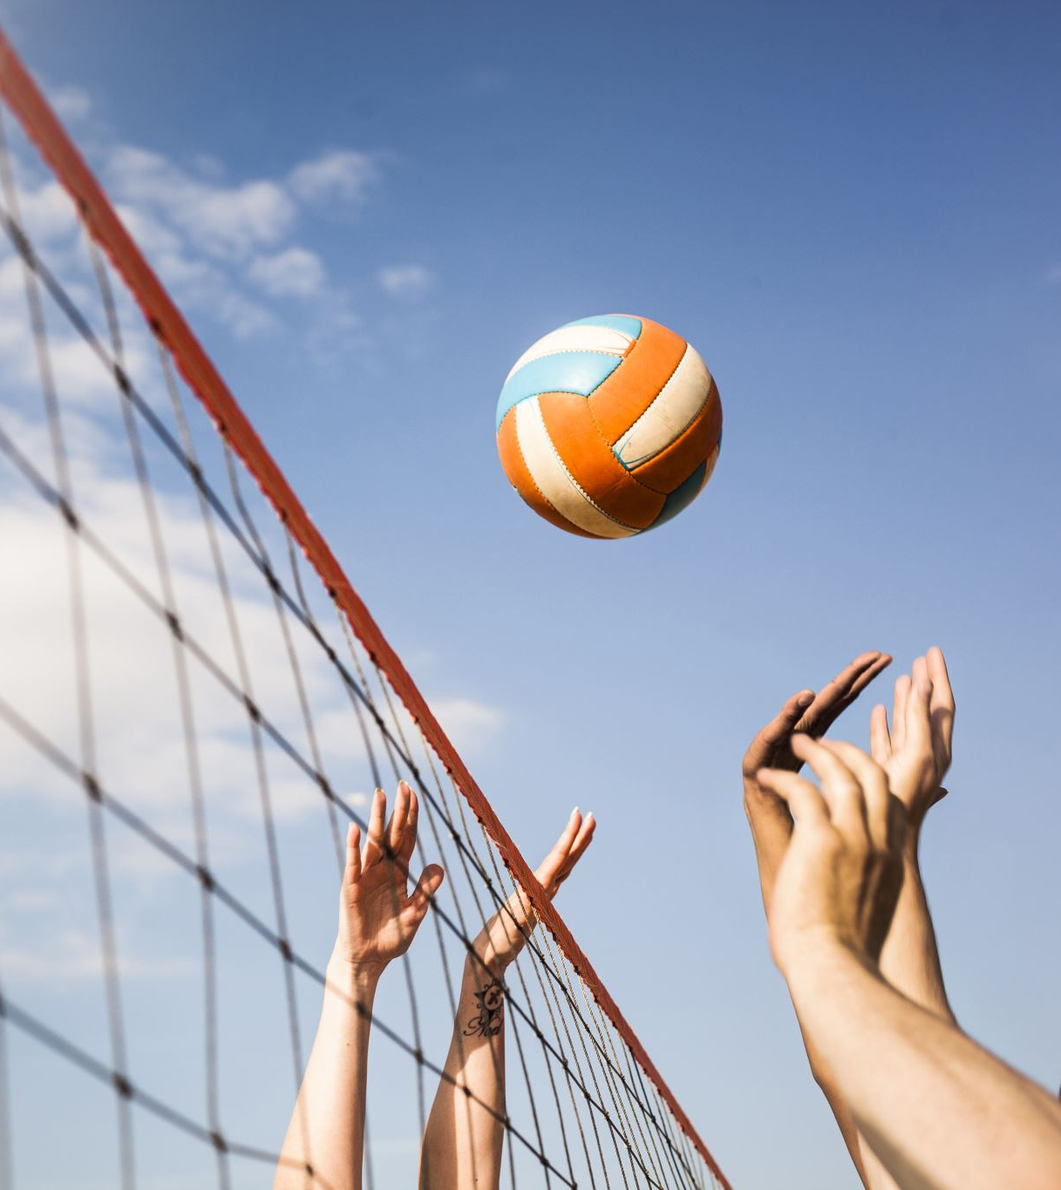
Contact information
Athletic Director – Dylan.Metz@osceolaschools.net
Assistant Athletic Director – Lynnsey.Cranmer@osceolaschools.net
Intramural Director – Robert.Herbert@osceolaschools.net
Cross Country – Robert.Herbert@osceolaschools.net
Boys Soccer - Angel.Gonzalez@osceolaschools.net
Girls Soccer – Jaila Decker
Girls and Boys Volleyball - alexis.santiago@osceolaschools.net

Slide 3
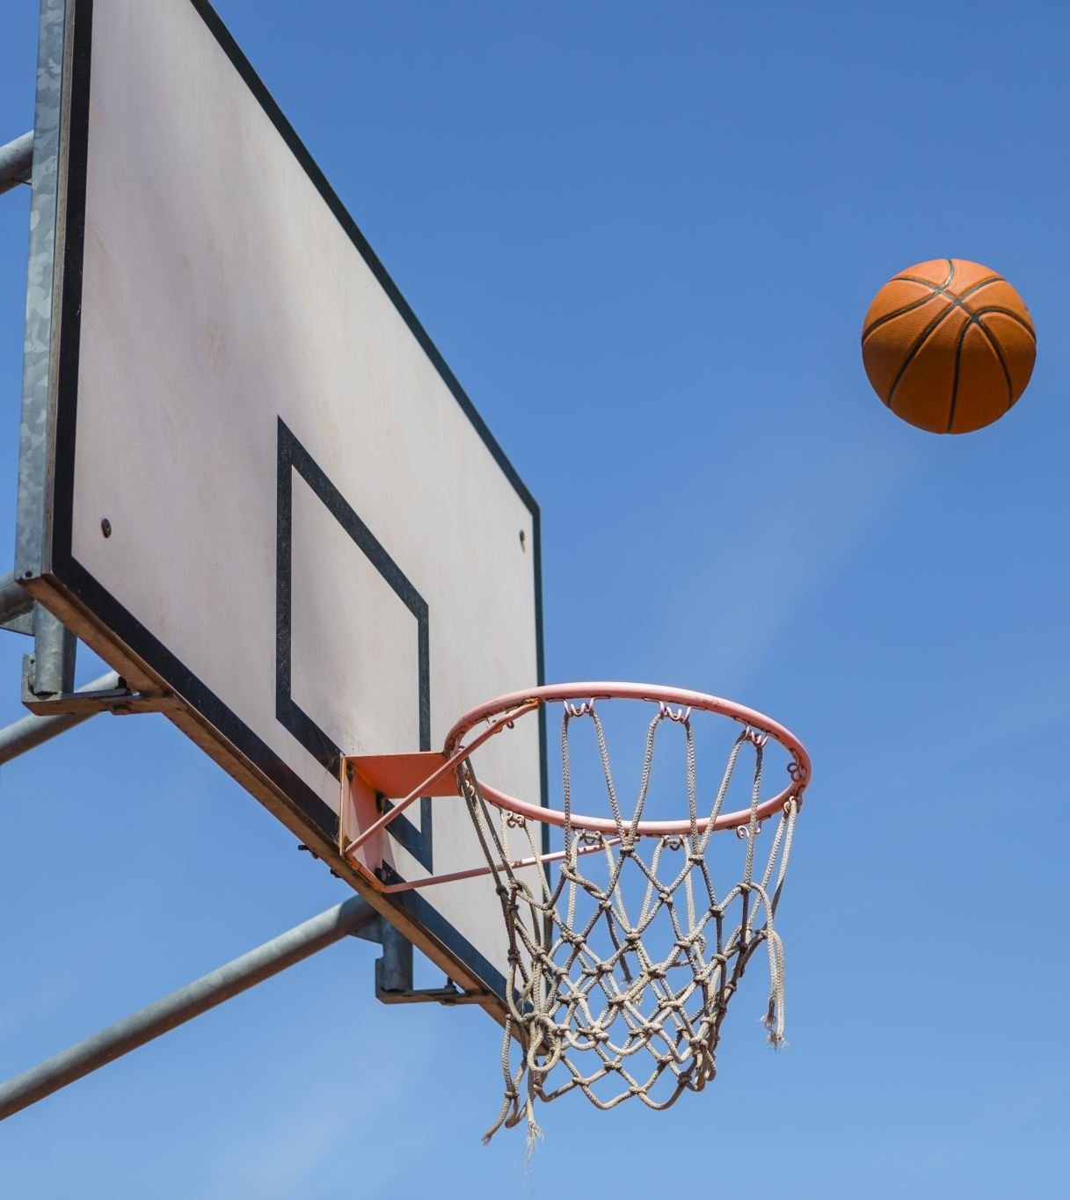
Contact Information cont.
Boys Basketball – Robert.Herbert@osceolaschools.net
Girls Basketball – Lynnsey.Cranmer@osceolaschools.net
Girls Flag Football – Alexis.Santiago@osceolaschools.net
Boys Flag Football – Angel.Gonzalez@osceolaschools.net
Track – Lynnsey.Cranmer@osceolaschools.net

Slide 4
Requirements
Current Sports Physical
Completed Aktivate Account prior to tryouts
Impact Concussion test
Can be found in Aktivate
Passing grades from the previous quarter*
*6th grade students wanting to play fall sports are exempt from this requirement. They must have passing grades in Q1 to be eligible for Q2 sports

Slide 5
Where to get physicals?
All paperwork is found in Aktivate and can be printed from Aktivate
East Lake Chiropractic and Medical Center
4028 13th St, Saint Cloud, FL 34769
Your PCP
Sports physicals need to be “cleared without limitations”, stamped by the office, and signed/dated by a doctor.

Slide 6
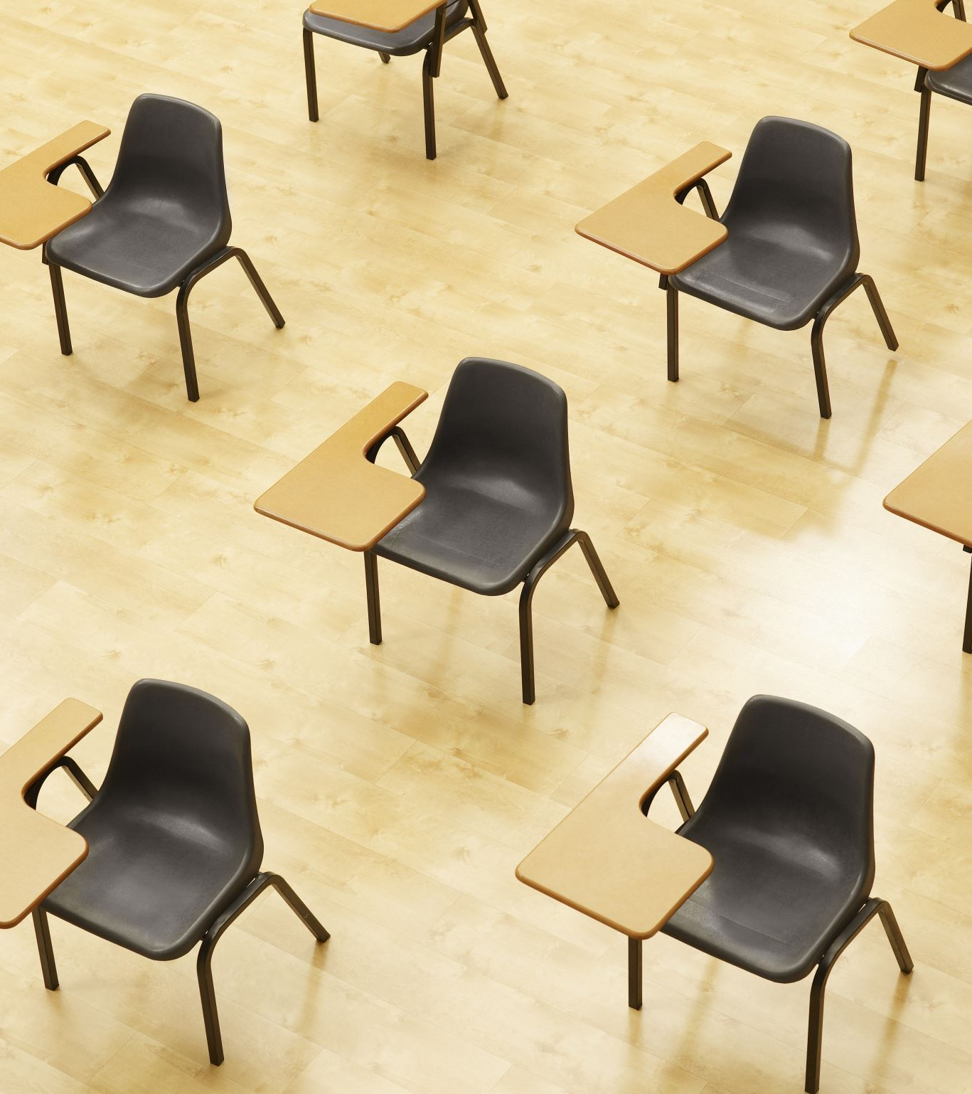
Concussion Test
Concussion test has to be done in one sitting
Cannot receive help on it
Can be found in Aktivate or on our school website:
Password is 2ENGKBPHEQ
You do not need to email the results to me

Slide 7
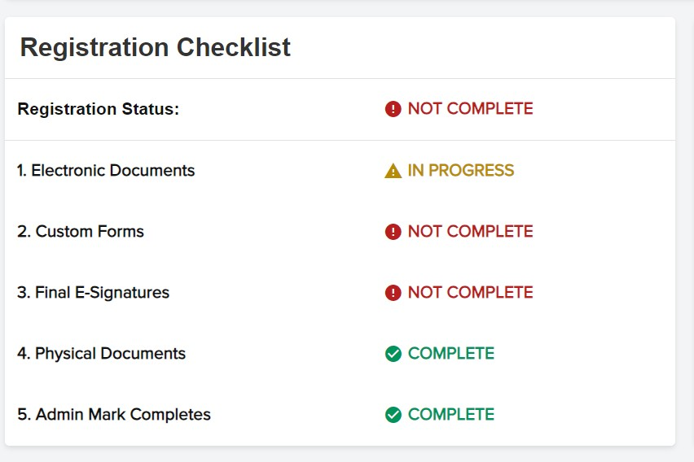
Aktivate
All paperwork must be completed in Aktivate
This is an example of a not completed account
You do not need to make a new account, just start a new registration for the 2024-2025 school year*
*6th grade students do not need make a new account if they have made one in 5th grade

Slide 8
Athletic Fee
Athletic fee is $20, per sport*
Athletic fees are used towards shirts we purchase for the kids and for uniforms incase anything gets ripped or lost or shrunk in the wash
We do use this fee to purchase seasonal equipment as well (volleyballs, basketballs, soccer balls)
Buying snacks/drinks for the teams for games
* Only need to turn in $20 if your athlete makes the team. This is not a blanket fee. We prefer cash for these fees as Aktivate or MySchoolBucks takes a % of your money

Slide 9
New Ticketing System
Using GoFan for our tickets
$3/2 for parents and students
We are still accepting cash in place of tickets but would prefer if GoFan was used. Cash price is $3/2
Not updated yet

Slide 10
Tryouts
All tryouts are closed to parents
Please plan on being at all tryouts unless there is a medical emergency as indicated on your physical by a doctor
All Aktivate information must be completed
When in doubt, reach out

Slide 11
Practice
Please communicate if you’re going to miss practices. Very helpful for coaches when figuring out starters and just keeping track of their team
All practices are closed. Parents will be asked to pick up/drop off students from the OVS parking lot
Please try your best to be on time. Things come up!

Slide 12
Safety and Security
House Bill 1473
Keeping routes of ingress and egress securely closed and locked when students are on campus, or actively staffed when open or unlocked.
This includes sports and afterschool activities

Slide 13
How this affects parents and athletes
Parents will need to pick their athlete up in the parking lot by OVS after athletic contest is over
We are only admitting parents through the gate at OVS
Not behind the school or in the main parking lot
Parents are allowed on campus 30 minutes before sport contest
Students must be accompanied by an adult while at sporting events. We are not allowing older siblings to provide supervision in place of an adult.

Slide 14
Where we need volunteer help
Being to practice and pick-up on time
Cheering our teams on and being at home games
Completing Aktivate stuff before the season/tryouts start
Helping us by following our Safety and Security rules

Slide 15
Questions?

